Slide 1
Flowe – an outsourcing case study

Slide 2
Flowe
Newco from Banca Mediolanum s.p.a.
Goals
Attract a different customer base
Learn about ‘new’ banks

Slide 3
The financial landscape
Flowe
Payments
Lending
Insurance
Money management
Wealth management
Trading
Traditional banks cover more than one item, possibly all of them
(Flowe)

Slide 4
Personas in finance
Innovators
Best price
Best quality

Slide 5
New bank scenarios (Flowe competitors)
Name | Services | Size | IT
Revolut | Account, payments, credit cards, expenses per category, | 10M users, 3500 employees | SDK.finance (Customization, on premise)
Oval | Account, money management, credit cards, payments | 0,5 M | Salt Edge
Hype (Banca Sella) | Account, payments, apple pay, google pay |  | Fabrick (Banca Sella)
N26 | Payments, credit cards |  | Mambu (SaaS)
Satispay | Payments only |  | In house
Flowe | Account, payments, credit cards. Educational resources |  | Temenos, Azure

Slide 6
Flowe values
Well being
Sustainability
well being economy
B certified company (pending), zero carbon emission goal

Slide 7
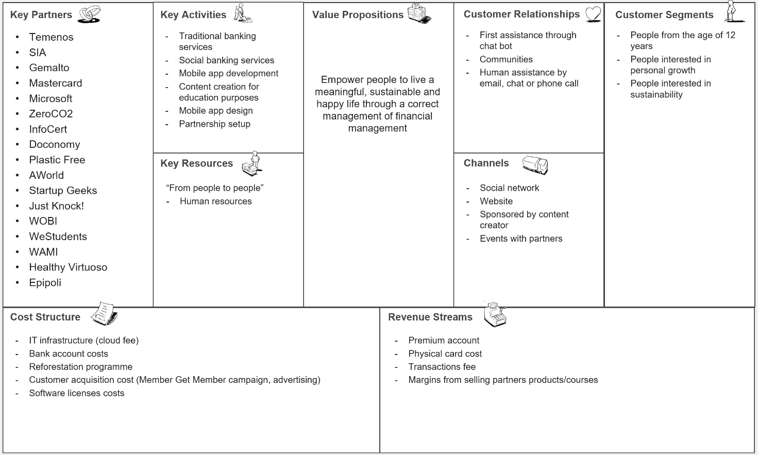

Slide 8
Organizational chart
50 people
Shared with Mediolanum
HR, Purchase, legal, internal audit, risk, compliance
5 ‘perspectives’
Value ecosystem
Experience design (IT staff)
Augmented intelligence (IT staff)
Happiness and services (IT staff)
Culture studios

Slide 9
IT decisions (from company strategy)
Alignment
Start from scratch (nothing from Banca Mediolanum)
Start fast, provide scalability (#users)
Concentrate on user experience
Focus on developing an ecosystem for people well being
Content on well being
Nutrition, health
Sustainability initiatives and metrics, company and individual
Plastic cleaning, ocean cleaning, CO2 reduction
Gamification
Use of app and financial education
Outsource
Core banking (not considered strategic)
Infrastructure (Azure)

Slide 10
Outsourcing
Location
Hosting, housing, web farming
Off-shore
Near-shore
Off-site
On-site
Dedicated
Shared
IT Infrastructure
Unicity
Application
ASP
BPO
BSP
Activity/Service

Slide 11
Infrastructure selection
Azure, due to previous close relationship with Microsoft

Slide 12
Application selection
Core banking
Anti money Laundering
Payments (Card management, payment gateway)
ID validation
Contract signature

Slide 13
Core banking

Slide 14
Functions
Area | Functions
Business functionalities | Bank data management, card management, payments support, tax management, anti-money-laundering, onboarding , … (72 items, 27 must have items)
Change, release management, ITOPS | new feature or custom modules, a well-documented services catalogue, availability of a critical support service, availability of different environment (development, test and production) and data streaming to external systems Availability 24/7
Monitoring and analytics | event correlation engine, log analytics with drill-down diagnostics, predictive analytics, recommendation on event remediation and event actions
Cost management | Flexible billing model (pay per use, pay per account) and a cost-tracking dashboard with reports (cost per user).
Backup recovery | Compliance with EU + italian law. No data loss, near real time recovery.
Security and compliance | Compliance with EU + italian law.

Slide 15
Weights
Area | Weight
Business Functionalities | 1
Change, release mgmt & ITOPS | 3
Monitoring and Analytics | 2
Cost Management and Resource Optimization | 3
Lifecycle, Backup and DR | 5
Identity, Security and Compliance | 5

Slide 16
Options
Product | Company | Comments
Fabrick | Banca Sella | Competitor, core banking on old technology (20 years)
Flexcube | Cabel/Oracle | On premise only
T24 | Temenos
Easybox | SIA

Slide 17
Scores and weights
Area | Weight
Business Functionalities | 1
Change, release mgmt & ITOPS | 3
Monitoring and Analytics | 2
Cost Management and Resource Optimization | 3
Lifecycle, Backup and DR | 5
Identity, Security and Compliance | 5
Core Banking | Business Functionalities | Change, release mgmt & ITOPS | Monitoring and Analytics | Cost Management and Resource Optimization | Lifecycle, Backup and DR | Identity, Security and Compliance | Total Score | Weighted total score
Temenos | 112 | 13 | 5 | 4 | 5 | 34 | 173 | 368
SIA | 68 | 11 | 3 | 4 | 5 | 31 | 122 | 299
Fabrick | 130 | 10 | 11 | 4 | 5 | 29 | 189 | 364
Cabel | 128 | 9 | 6 | 1 | 5 | 28 | 177 | 335

Slide 18
Recap on outsourcing decision
Activity is strategic?
Activity can be fully described?
Activity can be performed outside at lower cost / better quality?
Activity is subject to legal constraints?
To be answered
On infrastructure
On application

Slide 19
Infrastructure
Strategic: no
Fully describable: yes (commodity)
Better price / quality: better quality, price to be analyzed
Legal constraints: yes
Application: core banking
Strategic: no
Fully describable: yes (commodity)
Better price / quality: to be analyzed
Legal constraints: yes

Slide 20
Analysis, after the fact
Infrastructure
Pros:
Ease in scaling up with #customers (also abruptly)
No investment in hardware, no need to forecast the #customers
No investment in staff to operate and mantain the infrastructure
Possibility to change the pricing model
Related cost very clear
Fast deployment
Application
Pros
Fast deployment
Cons
T24 changes, some downtime (overnight)

Slide 21
Selection of other services
Anti Money Laundering: Temenos
Monitor transactions and customer, identify suspicious transactions
Strong Customer Authentication (SCA): Gemaito
At least two factors to authenticate customer (from PSD2)
Dynamic Linking: Gemaito
One time password for digital payments (from PSD2)
Payments (Card management, payment gateway): SIA
Interfaces Core banking with the payment circuit (credit cards, wire transfers)
Contract signature: Infocert
Supports signature of contract customer – bank, stores the contract (all digital)
Know Your Customer: Infocert
Characterize financial profile of customer at contract signature

Slide 22
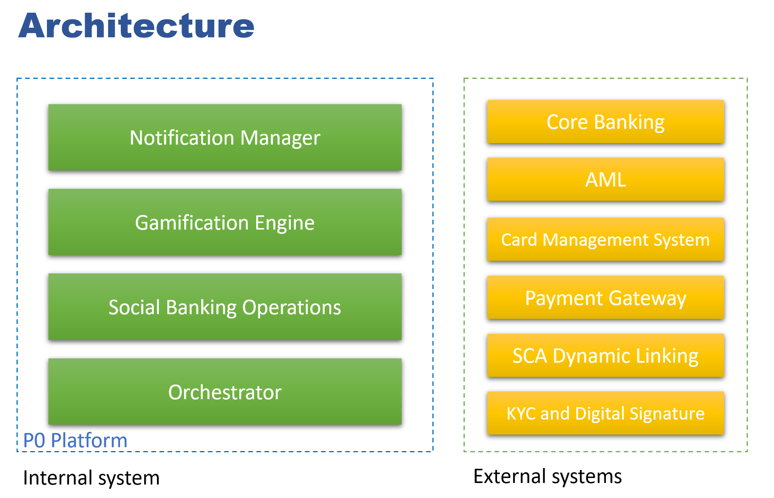
Architecture

Slide 23
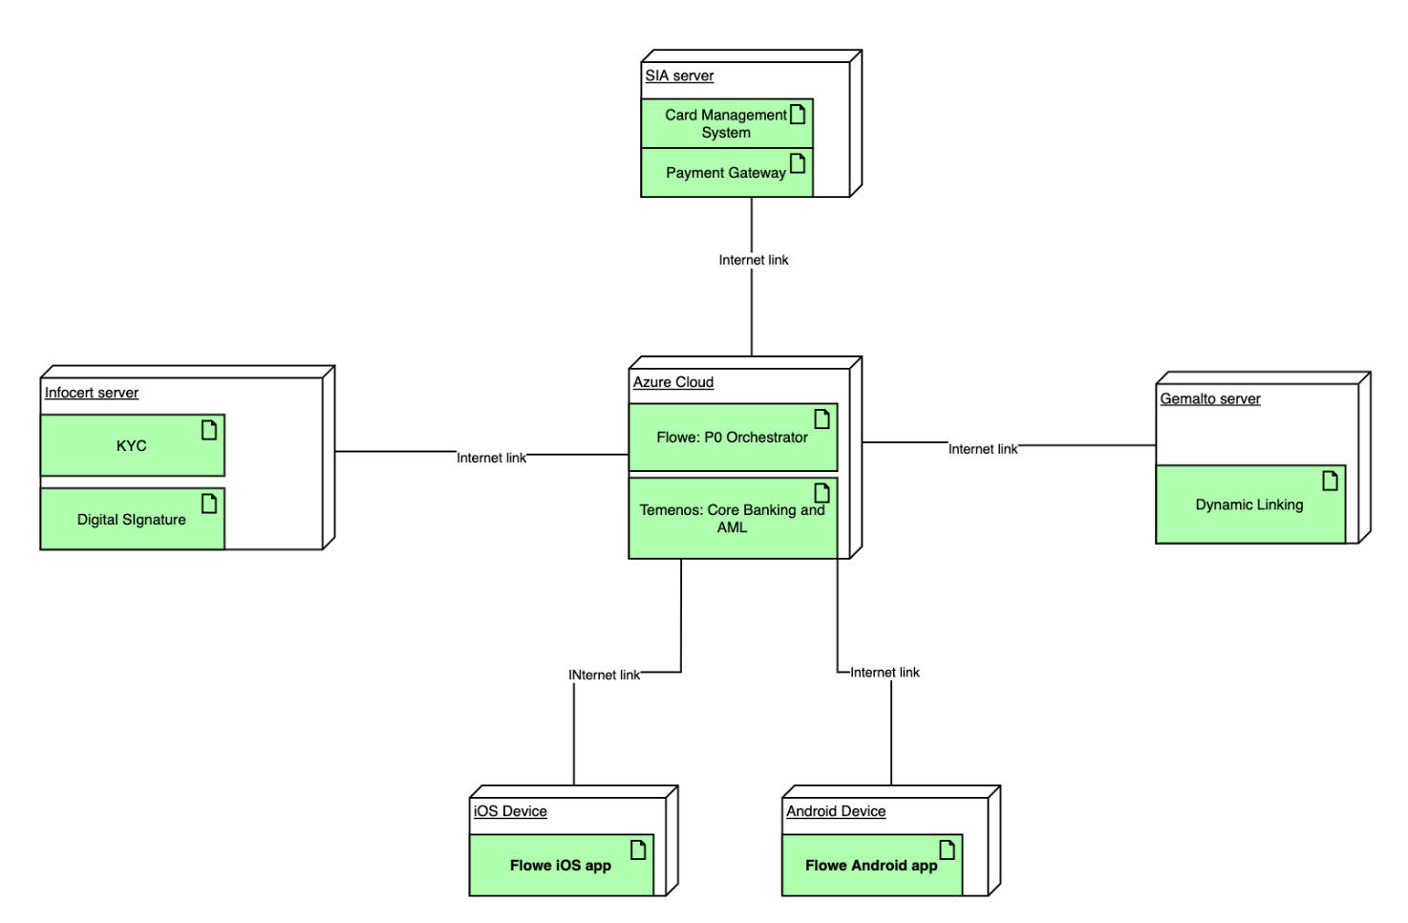
Deployment

Slide 24
Scenario: new customer registration
Step | Description | Component
1 | User opens the application for the first time and starts the registration process
2 | User inserts his/her phone number
3 | Phone number validation through OTP | Orchestrator
4 | User chooses a passcode | Orchestrator
5 | User inserts his/her email address
6 | Email address validation through OTP | Orchestrator
7 | P0 sends pre-contractual information documents to the user’s email address | Notification Engine
8 | User inserts personal information
8a | User scans passport or ID with NFC
9 | P0 sends the information to be validated to the relevant service | Orchestrator
10 | External service validates the document | KYC
11 | User records a short video of himself/herself
12 | P0 sends the video to be validated to the external service | KYC
13 | User inserts his/her income profile
14 | P0 uses the external AML service to assign an expenditure profile to the user | AML
15 | P0 prepares the contract for the user | Orchestrator
16 | User signs digitally the contract | Digital Signature
17 | P0 sends the signed contract to the user | Notification Manager

Slide 25
Scenario: payment
Step | Description | Component
1 | User pays in a shop with the debit card
2 | Card Management System handles the card payment | Card Management System
3 | Core Banking update the bank account balance and transaction accordingly to the payment notified by the Card Management System | Core Banking
4 | P0 receives the card payment event, and it updates the user’s transaction list | Orchestrator
5 | P0 notifies to app the successful payment | Notification Manager
6 | App shows the push notification
7 | If the user opens the app, the transaction list is updated with the new transaction

Slide 26
Summary
A case study on outsourcing and definition of architecture for a financial service provider
Outsourcing allows to start fast, scale up, control expenditures

